Slide 1
VE203 Recitation Class 8
Chenyu Zhu
July 25th, 2019

Slide 2
Outline
Chinese Remainder Theorem
Wilson's Theorem
Algorithms and Pseudo Codes
The Landau Symbol
The Order of Growth
Solving Recurrence Relations

Slide 3
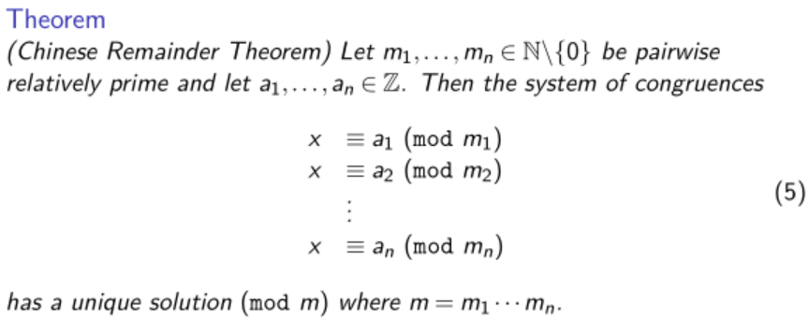
Chinese Remainder Theorem

Slide 4
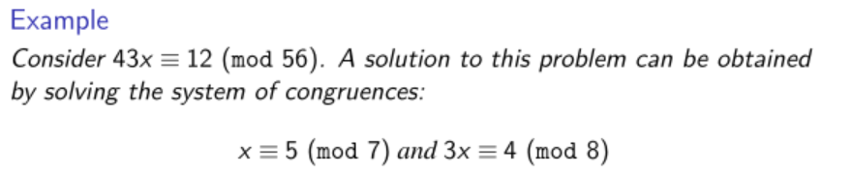
Chinese Remainder Theorem
What to do next?

Slide 5
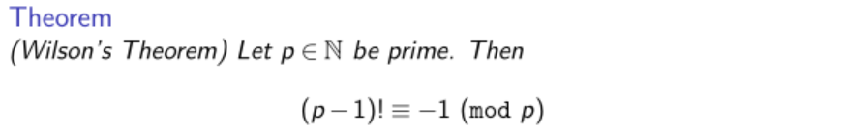
Wilson's Theorem
Proof:
Consider the group (Z/pZ)* and each element has its inverse
Consider those elements whose order is equal to 2

Slide 6
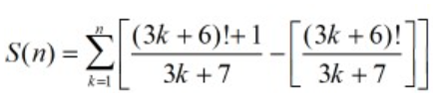
Wilson's Theorem
Example: Find the value of S(10) if

Slide 7
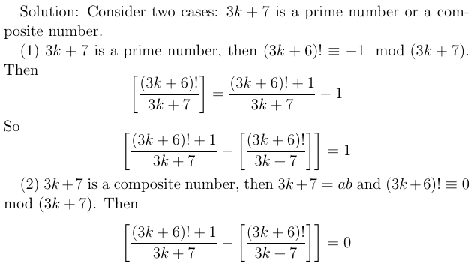
Wilson's Theorem
Example: Find the value of S(10) if

Slide 8
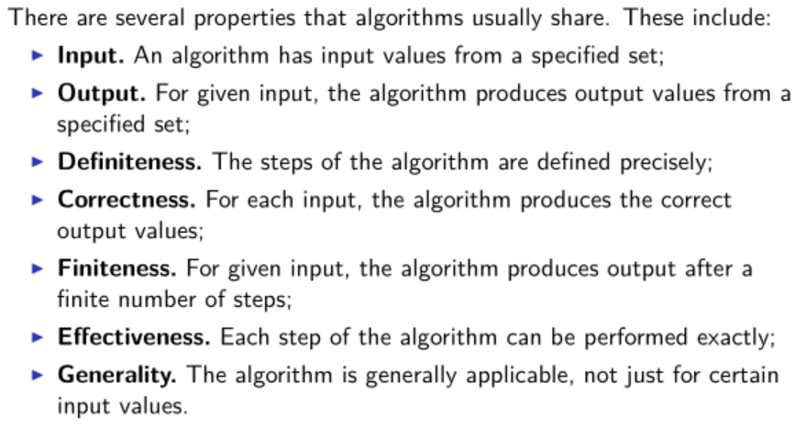
Algorithms and pseudo-codes

Slide 9
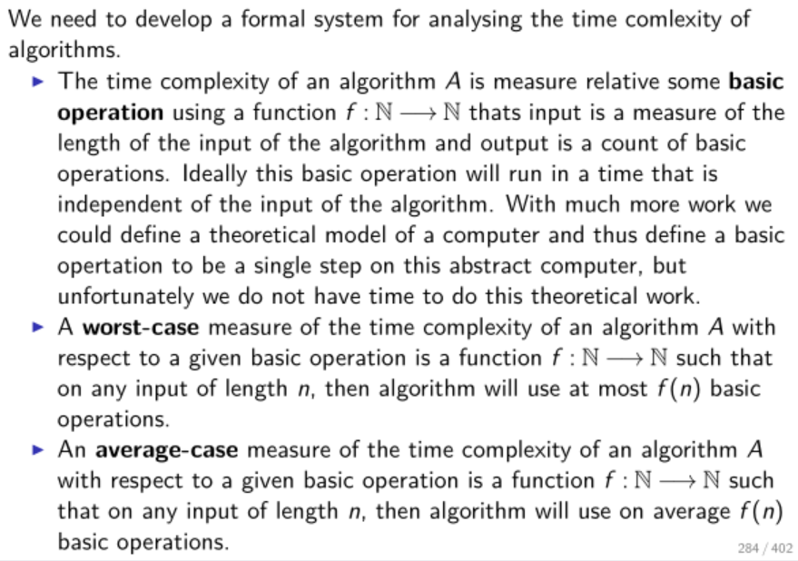
Time Complexity

Slide 10
Time Complexity
Usually we are concerned about the worst case time complexity instead of average time complexity since it's usually easier to determine and can give a upper bound of time.
Usually we are interested in large input sizes. It is because for small input sizes, the algorithm always runs very fast.

Slide 11
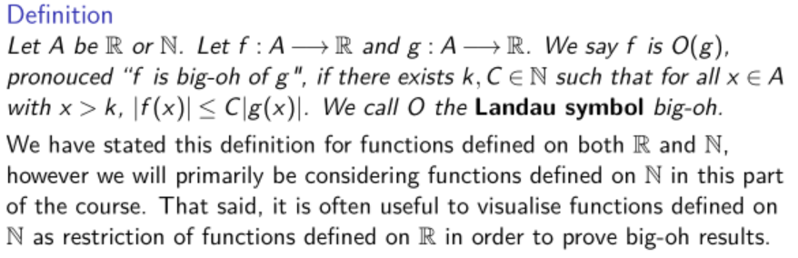
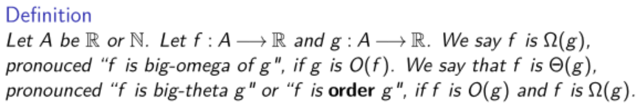
The Landau Symbol big-oh, big-theta and big-omega

Slide 12
The Landau Symbol big-oh, big-theta and big-omega

Slide 13

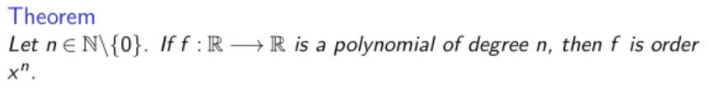
The order of growth
Summary: O(ln(n)) < O(n) < O(n*ln(n)) = O(ln(n!)) < O(n²) < ......
Summary: O(log₂(n)) = O(log₃(n)) = O(ln(n) = ......

Slide 14
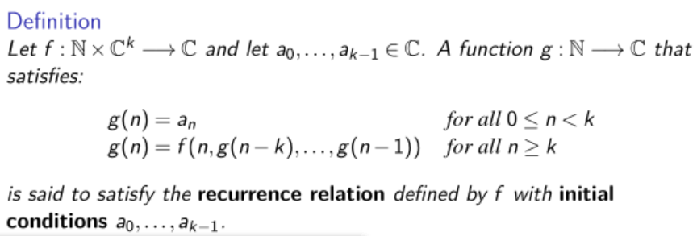
Recurrence Relations

Slide 15
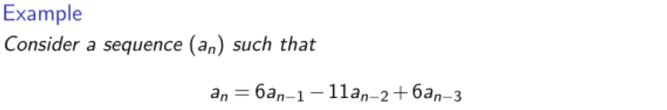
Solving Homogeneous Recurrence Relations
with initial conditions a₀=2, a₁=5, a₂=15

Slide 16
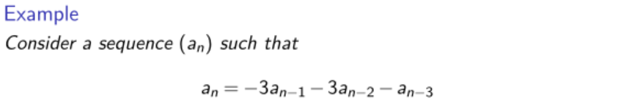
Solving Homogeneous Recurrence Relations
with initial conditions a₀=1, a₁=-2, a₂=1

Slide 17
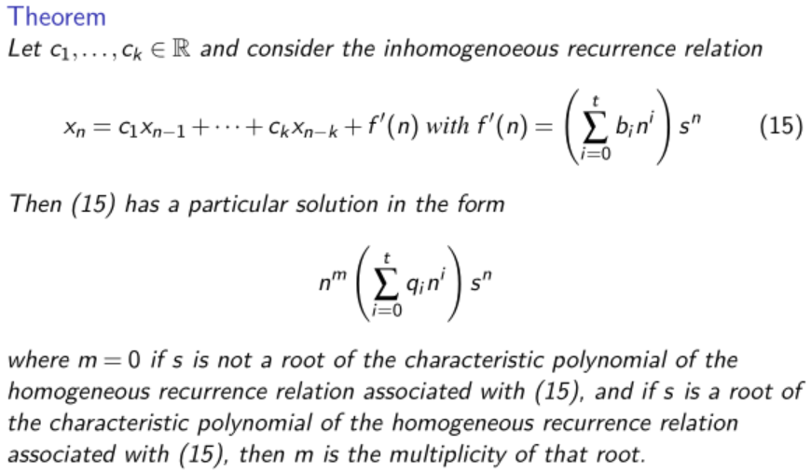
Solving Inhomogeneous Recurrence Relations

Slide 18
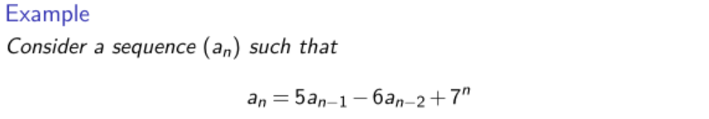
Solving Inhomogeneous Recurrence Relations
with initial conditions a₀=9/20 and a₁=43/20

Slide 19
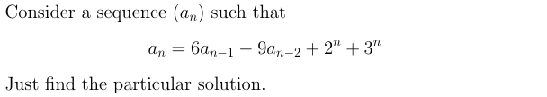
Solving Inhomogeneous Recurrence Relations

Slide 20
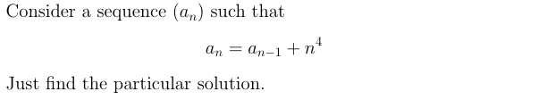
Solving Inhomogeneous Recurrence Relations

Slide 21
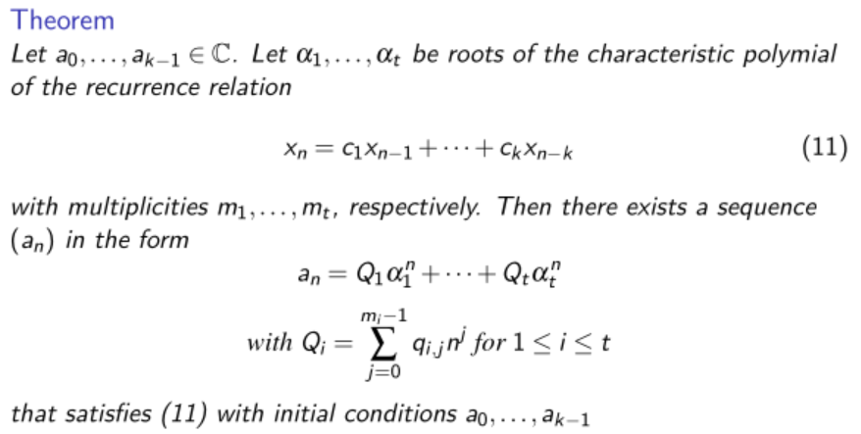
Summary: Solving Recurrence Relations
Homogeneous:
Solve the characteristic equation and find the roots together with their multiplicity

Slide 22

Summary: Solving Recurrence Relations
Inhomogeneous:
Solve the characteristic equation and find the roots together with their multiplicity
If different s^{n} terms occur in f'(n), just split into several sequences that have recurrence relations that has only one s'^{n} term in f''(n) (like the example on page 19)
Be very careful when 1 is a root of the characteristic equation!! (like the example on page 20)

